Slide 1


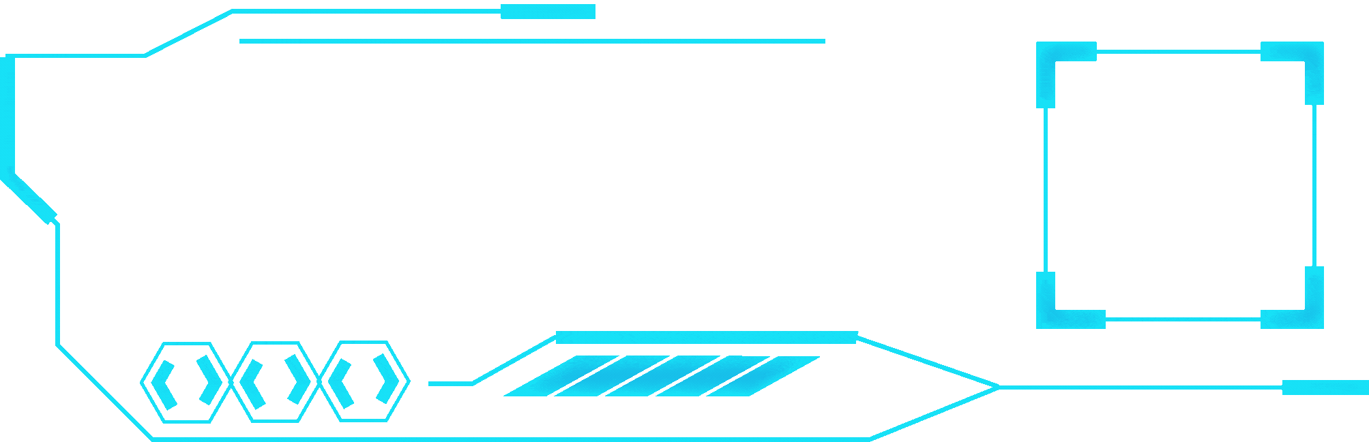


A PROJECT PRESENTATION BY K.S.CHAKRADHAR DANESH
ONLINE GROCERY STORE MANAGEMENT SYSTEM

Slide 2


CONTENT DONE BY CHAKRADHAR
ABOUT ME
I am Chakradhar, I finished my schooling at P.S. Senior Secondary School , and now I am studying B.Tech CSE Core at SRM Institute of Science and Technology. During my 12th grade, I acquired knowledge in Python and completed a project that I will be presenting today.

Slide 3



A CONTENT BY CHAKRADHARR
MISSION OF PROJECT
To enhance the conventional shopping experience and transition everything to a digital format.
To enhance the accessibility and convenience of online shopping for small businesses, regardless of their location.
01
02

Slide 4

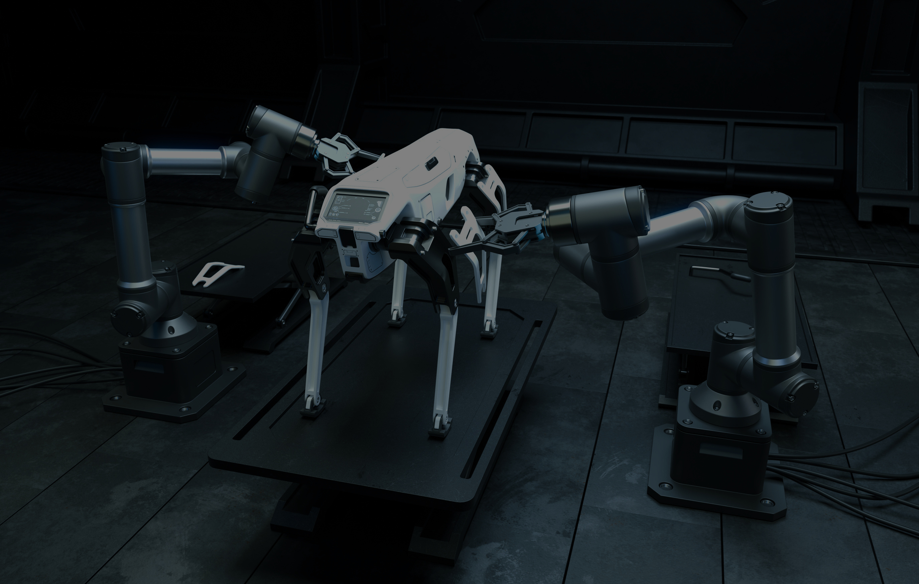


content by chakradhar
LET’S DVELVE INTO THE PROJECT

Slide 5


THANKING YOU HAVE A NICE DAY!

